Slide 1
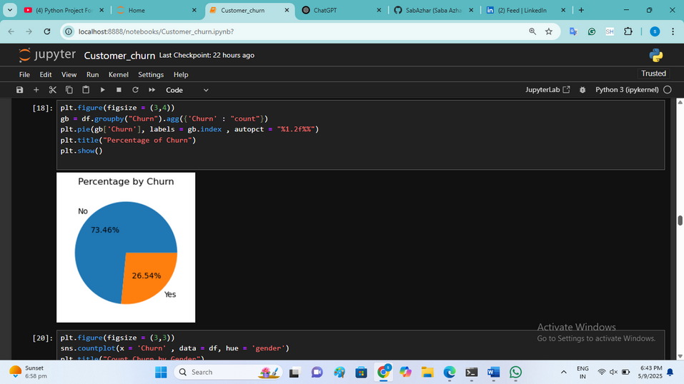
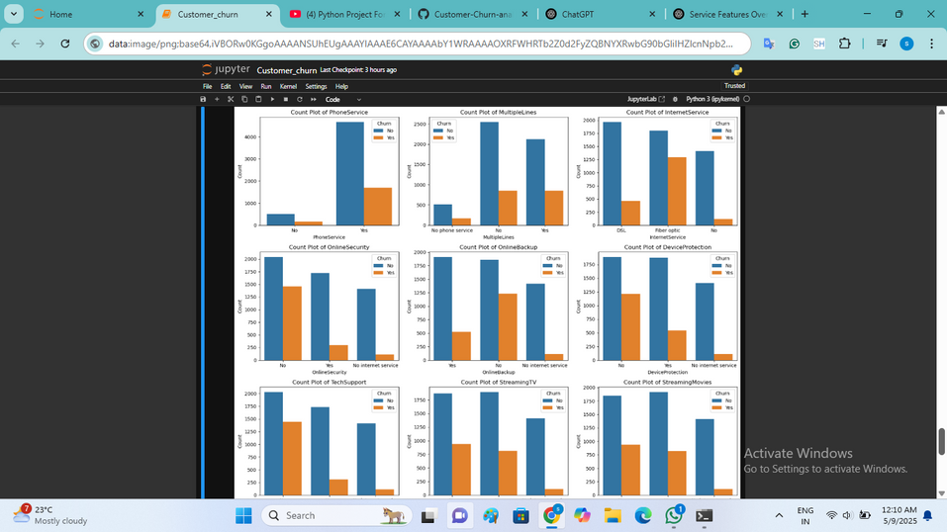
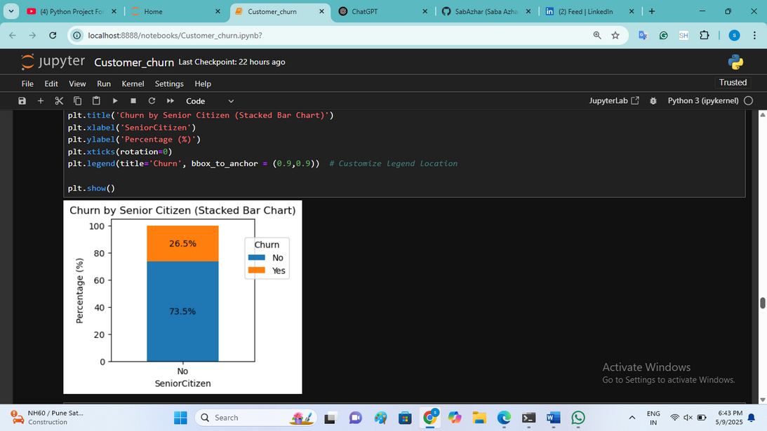
CUSTOMER CHURN REPORT
Key Performance Graphs
Percent By Churn
Subplot
26.54% of customers have churned, as seen in the churn distribution pie chart.
Customers with month-to-month contracts, electronic check payments, and fiber optic internet show significantly higher churn rates.
Churn By Senior Citizen
A comparatively greater percentage of senior citizens have churned, indicating a need for tailored customer retention efforts.

Slide 2
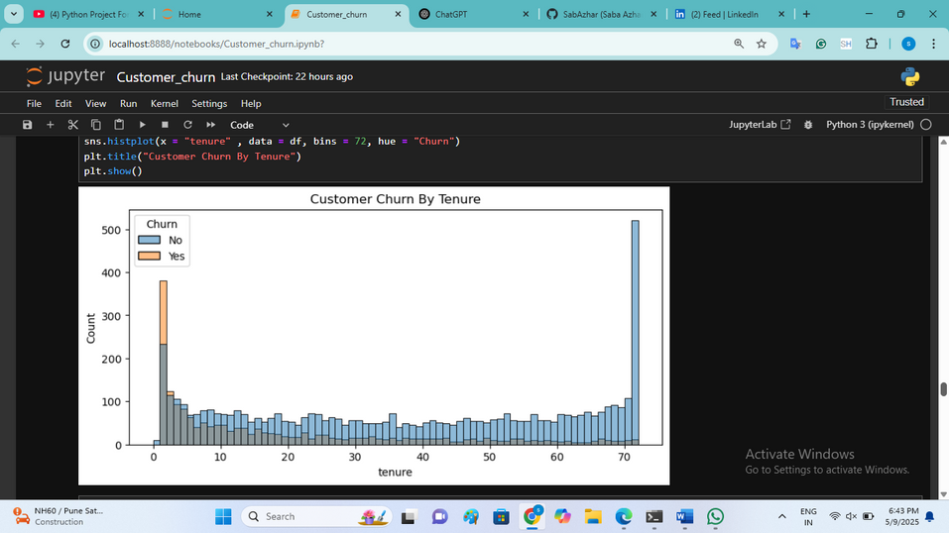
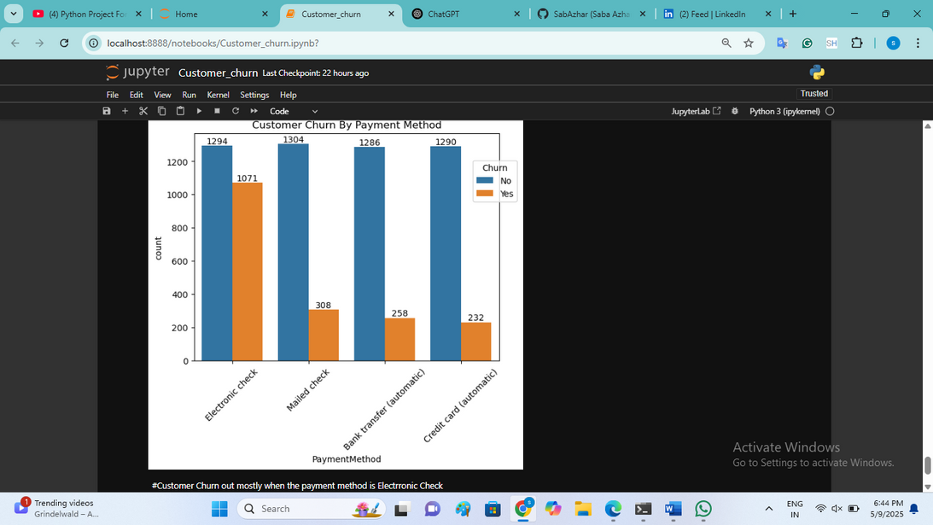
Customer Churn by Tenure
Customer Churn by Payment Method
Long-term contracts (1–2 years) and consistent service usage correlate with better customer retention.
Customer churn mostly when payment method is electronic check.

